Slide 1
API and Postman
JavaScript

Slide 2
What is an API?
API stands for Application Programming Interface. An API acts as a way for two pieces of software to interact or communicate.
For JavaScript in a web browser, this usually means using your script to send and/or request data to websites or servers. For the server to understand your data or request, however, you’ll often need to follow a specific format that the API requires.
There is more than one way to interact with an online API accessible from a web server:
Ajax
Web Browser
Web API Client
Software (including website back-end scripts)

Slide 3
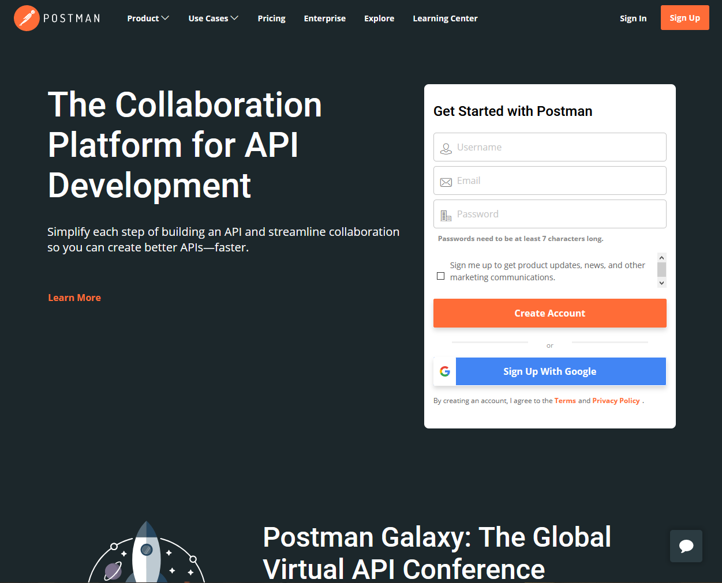
Web API Client
Before we write any code, let’s use a web API client to read data from a web server. It is helpful to know that the API endpoint (web address for the resource) exists and is in working order before we write any code trying to access it.
One of the most popular right now is Postman, but there are open-source alternatives like Insomnia and Milkman.
We’ll be having a look at Postman in this class.

Slide 4
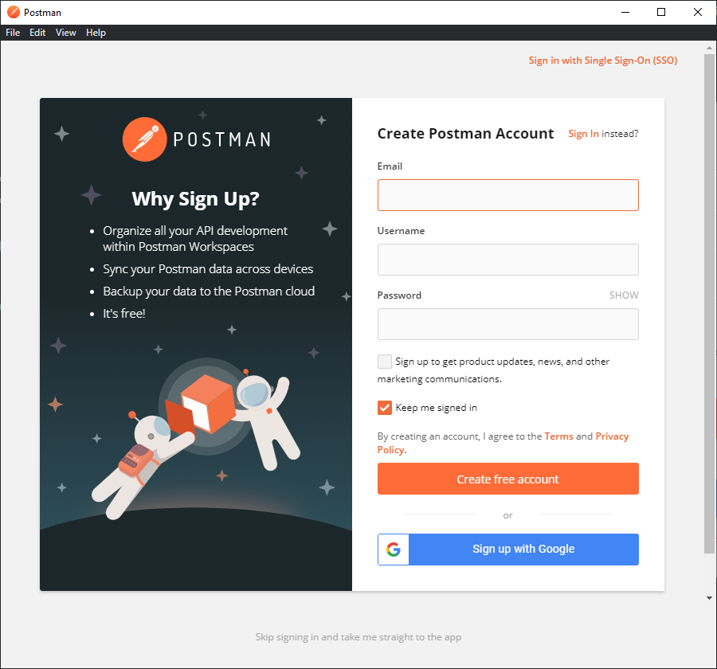
Postman
Download the application and let’s give it a try!
It is recommended you create an account if you’d like to save and keep track of your API requests and tests; you can skip the sign-in step in the program by clicking the “skip” button featured at the bottom of the window if that isn’t important to you.
Once you’ve skipped or signed in, you should be met with the Postman Launchpad. It offers a few suggestions, settings, and the latest Postman news.

Slide 5
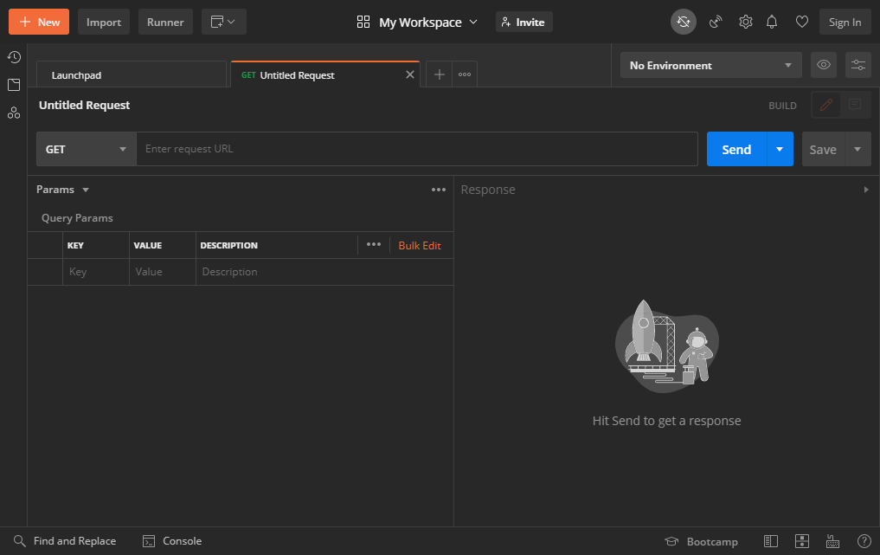
Building Requests
Click the “+” beside the “Launchpad” tab title, and you can create a new request tab. Here we can enter request data, and see what sort of response (if any) we receive back.
Try typing https://google.com into the request URL text field.
Click the “Send” button. What happens?

Slide 6
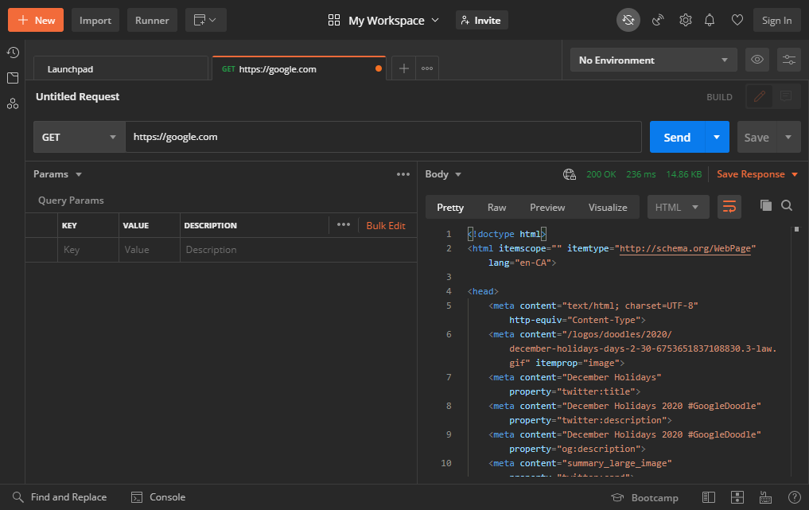
Interpreting a Response
The response pane features details about what the client received from the server.
Notice that the string of characters returned to us from that endpoint were a webpage—this is HTML code!
Making a request to Google’s search engine website gave us an HTML-formatted response.

Slide 7
Responses
Responses from web servers come in all sorts of types, shapes, and sizes. Some formats you may encounter include:
Raw Text
HTML
XML
JSON
Serialized
The most common of these in the modern web is JSON; the biggest reason for this being that JSON is immediately compatible with JavaScript—one of the three languages of the web. It is also relatively easy for both people to understand and for scripts to work with, making it an attractive choice even outside of the context of web.

Slide 8
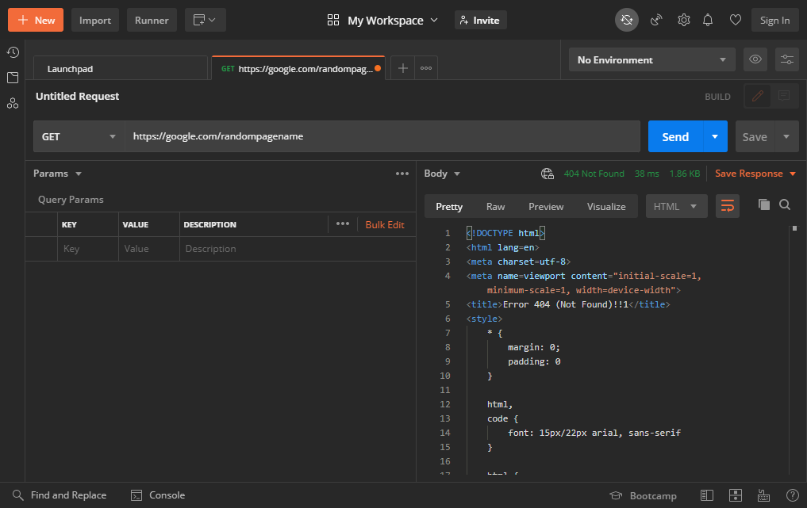
Submitting an Invalid Request
Look closely at the <title> contents for the new response. “Error 404,” it exclaims!
Where does that number come from, and how might it help us troubleshoot?
Let’s change our request to…
https://google.com/randompagename

Slide 9
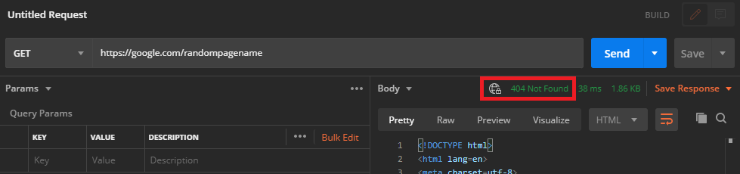
HTTP Response Status Codes
If you look closely at the top of the response pane, you’ll notice a number (and sometimes text)...
This is referred to as an HTTP response status code.
It can be helpful to reference their meanings when receiving unexpected results from a web server.
The basics look like so…
Info (100-199)
Success (200-299)
Redirection (300-399)
Client Error (400-499)
Server Error (500-599)
These are ranges that give you a basic idea, but specific numbers in your response can give you more info as to what is happening.
Have a look at this list for more—some might be familiar!
Notes:
Which status does 404 fall under? What does it mean?

Slide 10
Learning About an API
APIs typically require us to use a specific web address, and sometimes we’ll even need to send data along to receive the response we’re expecting. In a well-supported API, we should be able to research these requirements via that API’s documentation.
As an example, let’s say we wanted to retrieve cat facts. With some research you may find that there is a free API out there on the web that can give us that exact information: Alex Wohlbruck’s Cat Facts API.
Visit the website: https://alexwohlbruck.github.io/cat-facts
You’ll notice that on the Cat Facts website there is a section with a heading that reads “API Documentation”. Bingo!
Click the link there to access their documentation.
Notice that this documentation mentions a “base URL”. This means that all of your request addresses will begin with that URL.
It also describes endpoints, these are what you add on to the end of the base URL to make different types of requests.

Slide 11
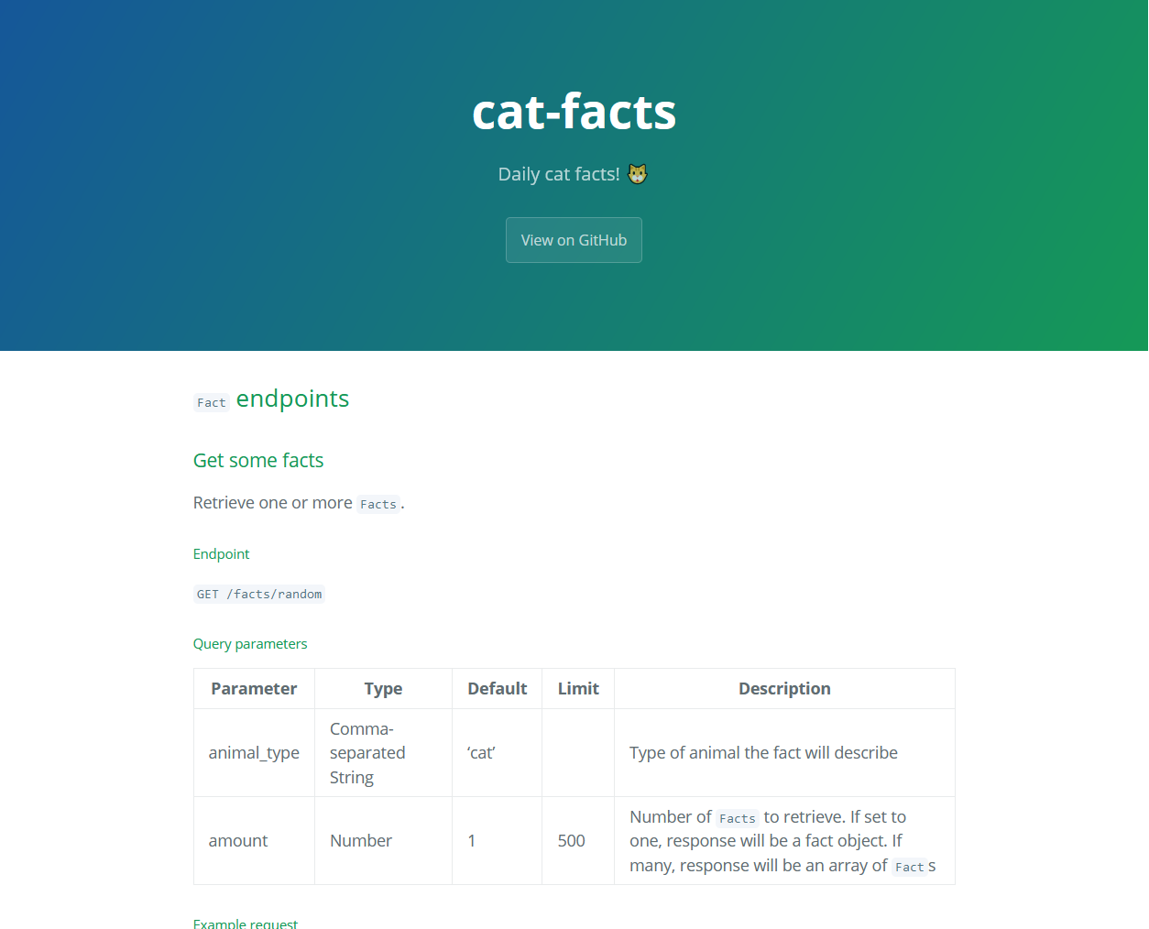
Using an API
Clicking the “/facts” endpoint will deliver you to the documentation for that particular endpoint.
Reading carefully it informs us as to how we can use the Cat Facts API to retrieve one or more facts.
Using parameters (animal_type and amount, in this case) we can modify what sort of response we might get.
Well-written documentation often features example requests and responses so you get an idea on what format you need to use, and what format you’ll get back.
With the Cat Facts API we must use query string parameters if we want to modify our request.
Responses from the Cat Facts API will be in the JSON format.

Slide 12
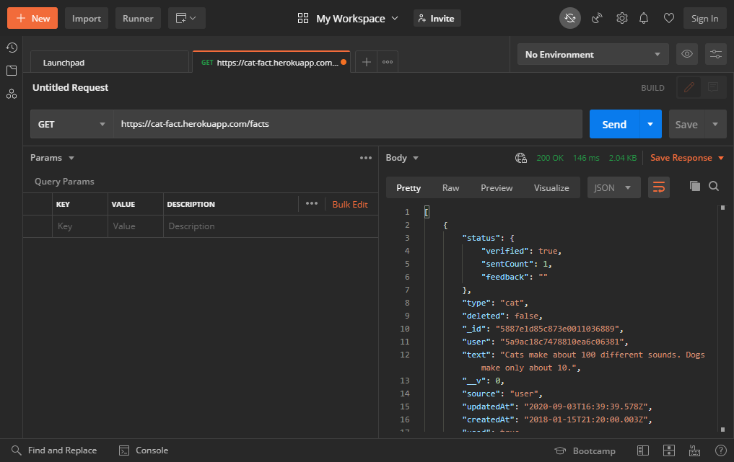
Retrieving a Cat Fact
Let’s try entering the following request: https://cat-fact.herokuapp.com/facts
What does the response contain?
Can we make our request more specific?
If we combine the base URL cat-fact.herokuapp.com with the endpoint /facts, we should receive a response!
Notes:
The response is an array of objects. Each object has properties that we can use to further describe them. There should be a default of 5 cat facts in this response.

Slide 13
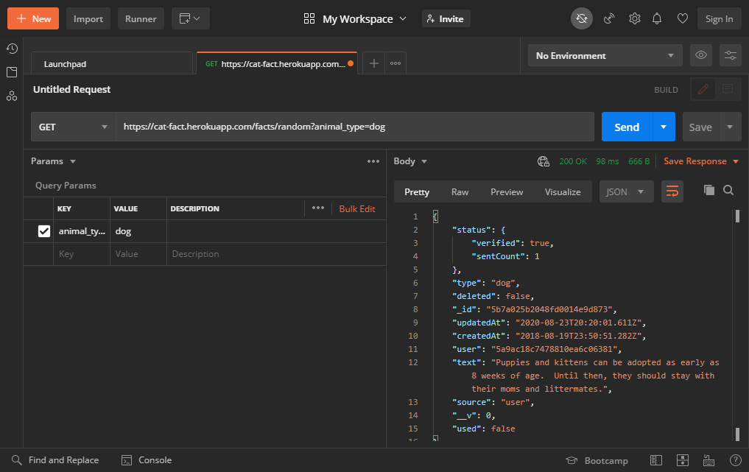
Retrieving a Dog Fact
Following the provided instructions for using the “/facts” endpoint, it appears we’re able to add a query string parameter and value for “animal_type”.
Let’s tell the API that we want a dog fact this time: https://cat-fact.herokuapp.com/facts/random?animal_type=dog
Note the animal types described in the fact model table: https://alexwohlbruck.github.io/cat-facts/docs/models/fact.html
Notes:
When it comes to “GET” query parameters, they can be typed directly into the full request address or you can simply type them in as “Keys” and “Values” in the “Params” pane within Postman.

Slide 14
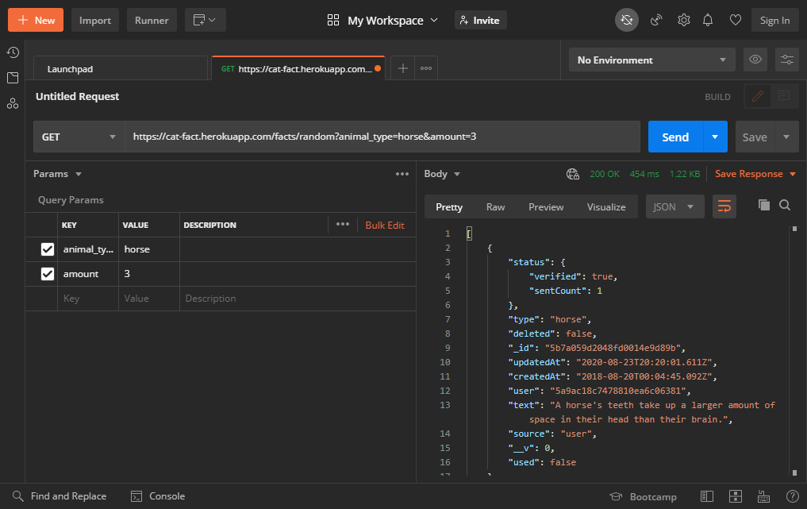
Retrieving a Specific Number of Horse Facts
Perhaps we don’t want only one horse fact, we want three. Let’s specify that in our next request!
Enter two keys and values this time…
https://cat-fact.herokuapp.com/facts/random?animal_type=horse&amount=3
Let’s try adding two parameters to our request this time: animal_type and amount.
Notes:
When it comes to “GET” query parameters, they can be typed directly into the full request address or you can simply type them in as “Keys” and “Values” in the “Params” pane within Postman.

